Slide 1
3-Year Recidivism for Offenders Released from Prison in Iowa
Michael Moravetz
Data provided from the Iowa Department of Corrections

Slide 2
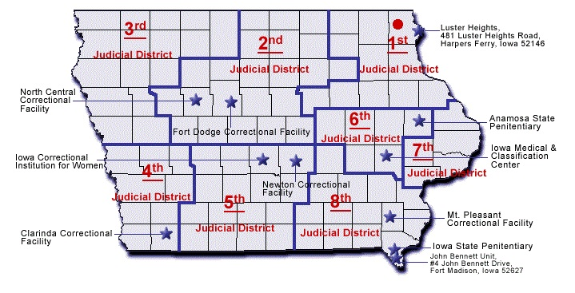
Features Considered
Age of Release
Supervising District
Year of Release
Race and Ethnicity
Class of Crime
Subclass of Crime
Sex
And More!
Source : https://data.iowa.gov/Public-Safety/3-Year-Recidivism-for-Offenders-Released-from-Pris/mw8r-vqy4

Slide 3
Supervising District

Slide 4
Age of Release
Age of Release by Maximum Sentence

Slide 5
Race and Ethnicity

Slide 6
Recidivism and Race

Slide 7

Catboost Classifier 78% AUC
Important Features for Classification Model

Slide 8
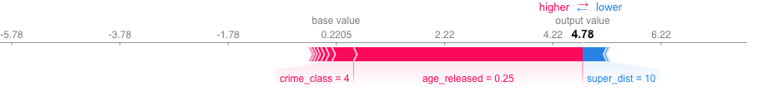
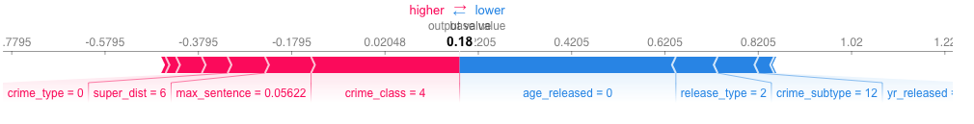
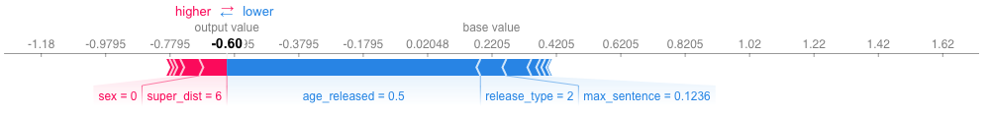
Feature Force In Model

